Slide 1
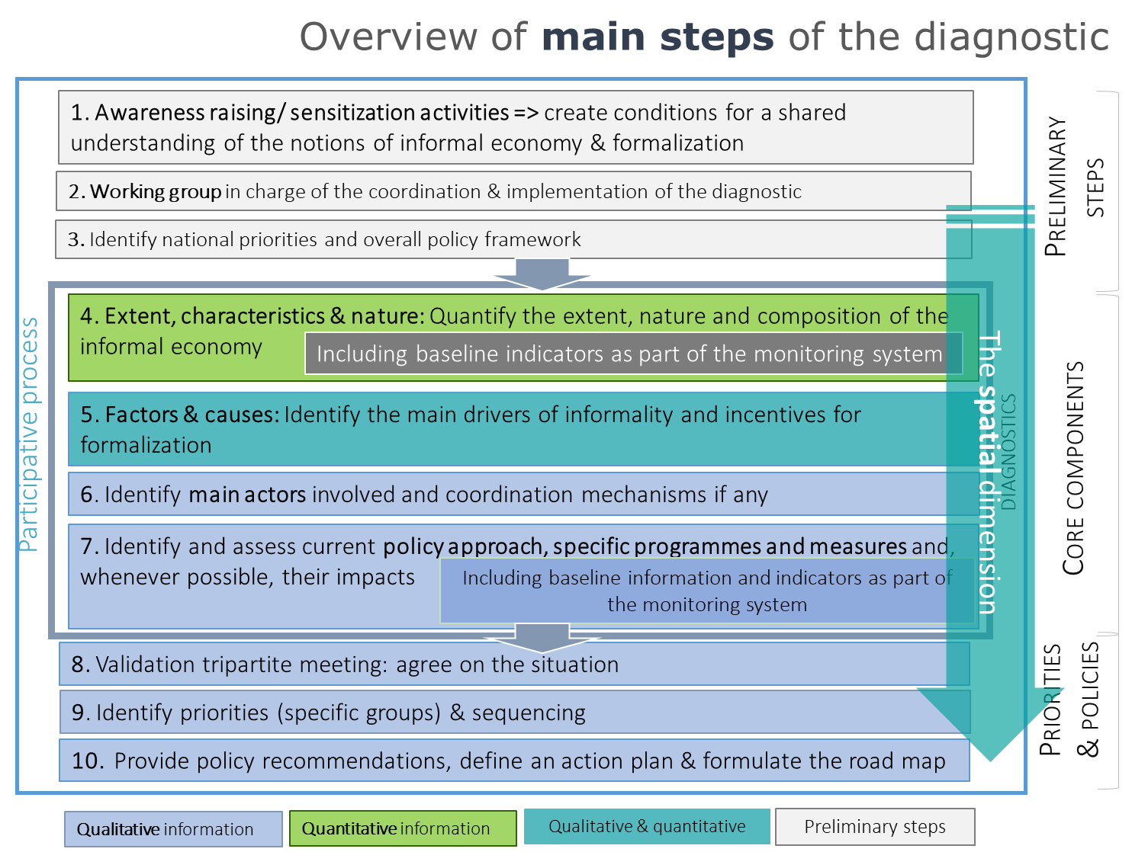
Session 3.3
National diagnostic of informality or how data support decisions about priorities and inform the development and monitoring of policy
Regional Course on Statistics on Informality:
Definitions, Measurement, SDGs and Other Policy Indicators
15-18 October 2024, Chiba, Japan
Florence Bonnet AP/FORMALIZATION (bonnet@ilo.org)

Slide 2
Introduction — scope of the session
      Some background
      The Recommendation 204 concerning the transition from the informal to the formal economy calls Members to undertake a proper assessment and diagnostics of factors, characteristics, causes and circumstances of informality in the national context to inform the design and implementation of laws and regulations, policies and other measures aiming to facilitate the transition to the formal economy.
        Will provide a very short overview of the Recommendation 204
      Main scope of the session
        An overview of the main objectives and main steps/ components of the diagnostic of informality
        A complement to the quantitative assessment through indicators as presented in sessions 3.1 & 3.2
          Additional drivers of informality
          Linking qualitative and quantitative information: assessing the extent of the legal coverage and implementation gaps
        The basis (including additional information) in the context of the Abelina case study used for the groupwork

Slide 3
1. Facilitating the transition to formality
The Recommendation 204: what formalization means and what formalization processes entail?

Slide 4
The significance of the Recommendation 204:
Transition from the informal to the formal economy
Adopted in 2015, first international standard to provide both a normative and a developmental framework
  Focusing on the informal economy in its entirety and diversity
  Indicating a practical guidance for moving out of informality and transitioning to the formal economy through integrated strategies
R204 calls for data and statistics to identify the nature and extent of the informal economy [para 6] calls members to undertake national diagnostics of informality [para 8]
Some guiding principles
  the necessity to address the diversity of characteristics and needs of workers and economic units in the informal economy with tailored approaches;
  the specific national circumstances, legislation, policies, practices and priorities for the transition to the formal economy
  the preservation and expansion, during the transition, of the entrepreneurial potential, dynamism, skills and innovative capacities;
  the need for a balanced approach combining incentives with compliance
  The importance of social dialogue
6. …. given the diversity of the informal economy across member States, the competent authority should identify the nature and extent of the informal economy as described in this Recommendation, and its relationship to the formal economy.
8. Members should undertake a proper assessment and diagnostics of factors, characteristics, causes and circumstances of informality in the national context to inform the design and implementation of laws and regulations, policies and other measures aiming to facilitate the transition to the formal economy.

Slide 5



Why is transition to formality important?
Formalization is not an objective in itself but a necessary condition to reach other important objectives
For workers | For enterprises | For governments
Decent work Recognition as worker Labour and social protection Income stability Voice and collective representation & effective participation in social dialogue
Recognition of the activity; of the right to do business
Access to productive factors: credit, technology, markets
 Increased productivity
Fairer distribution of the tax burden among enterprises / fair competition
Sustainability & ability to provide decent working conditions for the owner and decent job opportunities for others
Enhances the government scope of action by:
    allowing increased public revenues
    strengthening the rule of law
  Culture of compliance, reducing the room for corruption
  Contributes to fairer societies by distributing rights and obligations among its members more equitably
  Formalization is thus a condition for the decent work agenda to become a reality
  … and a condition for achieving several SDGs: R204 can be seen as one of the “tools” to support the realisation of multiple SDGs

Slide 6
Other importants issues about formalization processes
      Formalization pursued through three complementary channels (which are the objectives of ILO Recommendation 204 )
        Transitioning workers and economic units from the informal to the formal economy (indicators suggested so far focus on this first objective)
        Creating decent jobs and sustainable enterprises in the formal economy
        Preventing the informalization of jobs.
      Reducing decent work deficits in the informal economy as one of the results of formalization but, at the same time, an enabling condition that facilitates transition to formality and, as such, it can be considered as part of the formalization process.
        Recognizing that not everyone is already in a position to be formalized in a sustainable way: importance of assessing the various levels of protections & vulnerabilities in the informal economy

Slide 7
2. Objectives & main steps of national diagnostics

Slide 8
The intervention model
Sessions 3.1 and 3.2
Diagnostics phase
Quantify and identify prevalent forms of informality => includes drivers
Diagnostics phase
Review of legal & policy frameworks & practice
includes drivers
Development of integrated strategy & institutional framework
Implementation & monitoring
Inclusive social dialogue + coordination
Some éléments covered in this session

Slide 9
Diagnostics of informality: what and what for?
The starting point for a better understanding of the informal economy and the context:
  Level of informality, nature, characteristics of workers and economic units respectively in the informal and formal economy
  Comparison of working conditions, economic performance & sustainability in the informal and the formal economy
  Main drivers of informality and obstacles to formalisation
  Mapping and assessment of current policies/ measures including a mapping of actors & coordination mechanism
The opportunity to agree on a definition of informality & set the baseline for the monitoring of formalization progress
A comprehensive / inclusive process to build a large domestic consensus about the informal economy among main actors => Shared set of facts to be in a position to decide on priorities
  Aims to cover the multiple dimensions of informality:
  jobs, enterprises and contribution to GDP
  Beyond the dichotomy “formal-informal”
  Understand the heterogeneity and the need for tailored policies
  Identify those that are ready to transition to formality from those for who the priority is to reduce decent work deficits & create conditions for a transition at a later stage (sustainable transition)
Multiple issues covered; quantitative and qualitative information
Comprehensive (global to the national economy) or targeted to specific sectors, groups of workers or categories of enterprises
Oriented towards action: ensure the link with policy formulation
Should not be an ILO “predefined diagnostic process”
  A generic approach to adapt to country circumstances and priorities
  Active involvement at all stages of national actors, including social partners, informal economy actors; other UN agencies
1. Where are we now?
Bottom Line =
Evidence-based policy making

Slide 10
Overview of main steps of the diagnostic
1. Awareness raising/ sensitization activities => create conditions for a shared understanding of the notions of informal economy & formalization
Preliminary steps
2. Working group in charge of the coordination & implementation of the diagnostic
3. Identify national priorities and overall policy framework
4. Extent, characteristics & nature: Quantify the extent, nature and composition of the informal economy
Including baseline indicators as part of the monitoring system
5. Factors & causes: Identify the main drivers of informality and incentives for formalization
Participative process
DIAGNOSTICS
Core components
6. Identify main actors involved and coordination mechanisms if any
7. Identify and assess current policy approach, specific programmes and measures and, whenever possible, their impacts
Including baseline information and indicators as part of the monitoring system
  8. Validation tripartite meeting: agree on the situation
Priorities & policies
  9. Identify priorities (specific groups) & sequencing
  10. Provide policy recommendations, define an action plan & formulate the road map
Qualitative information
Quantitative information
Qualitative & quantitative
Preliminary steps

Slide 11
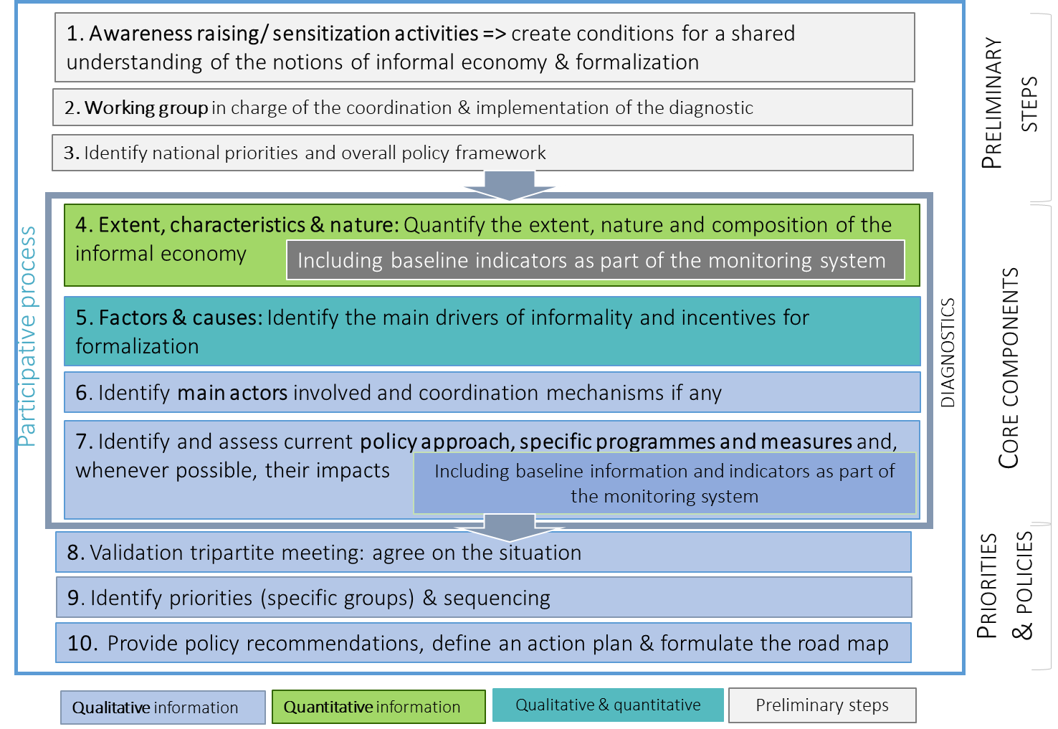
Preliminary steps

Slide 12
Preliminary steps (1)
A national workshop with representatives from Ministries involved in the formalization process (e.g. labour, social protection, economy, SMEs), national statistical office, enforcement bodies; representatives from workers’ and employers’ organizations dealing with the IE
Main goals:
  To lay the foundations for a common understanding of what informality means (including in statistical terms), why formalization matters & what processes of transition to formality entail
  Present the international statistical standards on informality and assess the situation at the country level:
    Whether there is a national agreed statistical definition of informal employment; informal sector, and if they are in line with international standards;
    If data on informality (job/work activities; economic units, contribution to GDP) are collected, analysed, disseminated and used for policy purposes
    Identify gaps to be addressed
Step 1 — Sensitization/ awareness raising activities on R204 as well as on the statistical concepts and definitions of informality

Slide 13
Preliminary steps (1)
Step 1 — Sensitization/ awareness raising activities on R204 as well as on the statistical concepts and definitions of informality
Objectives
Identification of national priorities and national strategic policy frameworks: national development plans, poverty reduction strategies, budgets, etc.
Does the country have a national development plan/strategy? If yes, what are the provisions affecting informality/formalisation?
Do existing sectoral policies and the related measures (e.g. fiscal incentives, infrastructure development) contain specific provisions to promote formalisation?
Identify if, as part of national priorities, there are particular sectors, groups of workers or types of economic units, forms of informality that could orient choices in terms of formalisation policies
First identification of experiences, programmes and projects in relation with informality and formalisation: past, current & planned
Assess if formalisation policies are linked to development strategies or how to link them?
Step 3 — Identify national priorities & overall policy framework

Slide 14

Step 4. Extent, characteristics & nature of informality
Covered in previous sessions

Slide 15

Step 4 — Objective (reminder)
Going beyond the dichotomy “formal-informal” to:
1.
Get a better understanding of informality in its diversity | Describing the informal economy and build a shared understanding of the situation (size, characteristics, causes and consequences)
2.
Support the development and implementation of policies to address the challenges associated to informality and facilitate the transition to formality
3.
Contribute to set the basis of the monitoring system and contribute to it

Slide 16
Step 5. Drivers of informality and of formalization

Slide 17
Main drivers of informality - Transversal versus specific to particular groups or economic units
Transversal drivers
Specific drivers
Transversal drivers are those that relate to all (or a wide set) of manifestations of informality.
They include notably:
inefficient public institutions
inappropriate macroeconomic frameworks
economic crisis
low level of education
low level of productivity
poverty, inequality
A number of major determinants of informality beyond the world of work fall into this group
That applies to:
Particular categories of enterprises: e.g. micro and small enterprises
Specific group of workers: based on their occupation (e.g. domestic worker); work location (home-based workers)
A (sub)-sector (e.g. agriculture)
Organization of work (e.g. digital platform workers)

Slide 18

Understanding the root causes of informality
  Information about the labour market at large
Information about the level and growth of GDP and the pattern of growth (sectors with high productivity-low job intensity/ low productivity-job intensive)
  To a large extent covered together with step 4 while identifying groups of workers, types of economic units most exposed to informality and working conditions
    See indicators presented in sessions 3.1-3.2
Effects
Root causes
Informality
Macroeconomic & structural causes
Characteristics of workers & economic units
Economic
Crisis (shocks)
Pattern of
growth
Structure of the labour market and of
the economy
Low education / skills
Poverty
Low level of
organization
Size of
enterprises
Low productivity
Low-, irregular income
Inequality
Motivation (e.g. flexibility)
Discrimination
Legal, regulatory and institutional framework
Regulatory framework inadequate or lacking
Lack of transparency and trust
Lack of communication and awareness
Weak enforcement systems
Low quality of social benefits/ services
Lack of incentives
Lack of support programmes for productivity enhancement
Lack of training opportunities
Lack of effective coordination & coherence between insitutions

Slide 19
Understanding the root causes of informality
  Collecting information on how the existing legal framework limits or enhances the transition to formality (creation of formal jobs; transition from informal to formal jobs & prevention of informalization)
  Seeking for the identification of the sources of the deficit of protection (for workers and economic units) among the three main possible sources:
    Lack of legal coverage
    Inadequate level of protection
    Non-compliance in practice
Requires a mix of measures on several fronts
  Legal dimension: adjust modalities as defined in the law to enhance their implementation in practice (ex. simplification; allow for flexibility)
  Improve enforcement mechanisms: assessment of compliance mechanisms including labour inspection, social security and taxes;
  Improve transparency, confidence in the system but also the provision of quality benefits & services: (institutions, procedures)
  Review of regulatory/ legal frameworks  identify gaps of legal coverage
    Who is covered (workers, economic units)? Who is not?
  Measures: Extension of legal coverage (reforming existing laws or adopting new laws) to categories not yet covered
  Are levels of protection provided by law sufficient: can we consider them as real protection?
    Assess for instance the capacity of social transfers to secure income
  Measures: Enhancing access to improved levels of protection (legal reform & implementation)
Effects
Root causes
Informality
  Lack of legal coverage
  Inadequate level of protection
Macroeconomic & structural causes
Characteristics of workers & economic units
  Non-compliance in practice
Economic
Crisis (shocks)
Pattern of
growth
Structure of the labour market and of
the economy
Low education / skills
Poverty
Low level of
organization
Size of
enterprises
Low productivity
Low-, irregular income
Inequality
Motivation (e.g. flexibility)
Discrimination
Legal, regulatory and institutional framework
Regulatory framework inadequate or lacking
Lack of transparency and trust
Lack of communication and awareness
Weak enforcement systems
Low quality of social benefits/ services
Lack of incentives
Lack of support programmes for productivity enhancement
Lack of training opportunities
Lack of effective coordination & coherence between insitutions

Slide 20
Step 5. Drivers of informality and of formalization
Identifying the “source of the deficit of protection” as part of the regulatory framework: scope and enforcement

Slide 21
Mapping enterprises & workers according to regulation scope and enforcement | Identifying the source of the “deficit of protection”
Contextual vulnerabilities
        Enterprises & jobs in Group A are formal
Considering « Legal framework» indicators?
        Group B workers and economic units fall in the scope of formal arrangements but are in informal employment because formal arrangements are not (or not sufficiently) applied.
          Measures, include:
          on the legal side, adjusting modalities as defined by law to enhance effective compliance;
          improve enforcement mechanisms;
          improve the type and quality of support and benefits provided.
 |  | 1) LEGAL COVERAGE by formal arrangements
 |  | Yes | No
2) EFFECTIVE COVERAGE | Application of laws in practice | Yes
 | No
Implementation coverage gaps
Formal | Within the scope of the law and complying [Group A]
Informal [Group B]
Within the scope of laws and regulations but voluntarily or involuntarily not complying
Informal [Group C]
Outside the scope of laws & regulations
Due to their characteristics
or “intentionally” after adjusting behaviour to be outside the scope of laws
        Group C workers and economic units fall outside the scope of formal arrangements
        … because ot their characteristics:
          Mainly an issue of extending legal coverage to categories not yet covered.
        … because they “choose to exit” from the scope of laws
Legal coverage gaps
Notes:
See legal framework indicators in ILO decent work indicators
Legal Framework Indicator 3. Unemployment insurance......................................................... Legal Framework Indicator 4. Statutory minimum wage .......................................................... Legal Framework Indicator 5. Maximum hours of work ........................................................... Legal Framework Indicator 6. Paid annual leave..................................................................... Legal Framework Indicator 7. Maternity leave ......................................................................... Legal Framework Indicator 8. Parental leave
Possibility to estimate legal coverage

Slide 22
Identifying the source of the “deficit of protection” |
Regulation scope and enforcement
« Legal framework» indicators
Primarily qualitative in nature as a start, those indicators may include information on:
The existence and description of laws, policies or institutions for a particular dimension of decent work
The identification of the groups of persons/workers/ economic units that these laws, policies apply to and qualifying conditions in terms of:
  Occupation or sector: agriculture is for example typically less regulated or subject to different regulations; domestic work does not fall under labour regulation in a number of countries
  Status in employment: own-account workers, contributing family workers and dependent contractors are often more likely to be excluded from the scope of formal arrangements
  Contractual arrangements/employment agreements: to what protections are attached the different types of employment agreements
  Size of enterprises (minimum threshold of size to be covered)
  + Qualifying conditions
    Minimum level of earnings or income
    Minimum number of hours of work
  Any other…
Benefits (level and duration)
The combination of qualitative & quantitative information allows for the estimate of the extent of the legal coverage (% of workers legally covered for a given protection)
…to be compared to indicators on coverage in practice (formal employment as a proxy)
… to quantify the extent of implementation gap
Notes:
See legal framework indicators in ILO decent work indicators
Legal Framework Indicator 3. Unemployment insurance......................................................... Legal Framework Indicator 4. Statutory minimum wage .......................................................... Legal Framework Indicator 5. Maximum hours of work ........................................................... Legal Framework Indicator 6. Paid annual leave..................................................................... Legal Framework Indicator 7. Maternity leave ......................................................................... Legal Framework Indicator 8. Parental leave
Possibility to estimate legal coverage

Slide 23
Example | Making decent work a reality for domestic workers:
Closing legal and implementation gaps
Source of the deficit of protection among domestic workers: as a percentage of all domestic workers, 2019
As a percentage of domestic workers in informal employment
Report | Making decent work a reality for domestic workers: Progress and prospects ten years after the adoption of the Domestic Workers Convention, 2011 (No. 189)
Notes:
Total coverage gap: Domestic workers in informal employment =
Legal coverage gap: Domestic workers not covered by social security laws (considering employment-related pension coverage) +
Implementation gap: Domestic workers included under the scope of social security laws (legally entitled to pension benefits) but not covered in practice.
18.8 per cent are formally employed (14.2 million), 53.9 per cent are excluded from labour and social security laws (40.7 million) and 27.3 per cent (20.7 million) are covered by labour and social security laws, but are still informal due to implementation gaps.
This means that of the 61.4 million domestic workers in informal employment, 66 per cent will require a first step towards formalization their inclusion in the scope of labour and social security laws. This is a prerequisite first step for the implementation of these laws and their effective access to protections. For the remaining 34 per cent of informal domestic workers, who are already included in the scope of social security and labour laws, the source of informality is the lack of application of such laws in practice.

Slide 24
Formalizing the 61 million domestic workers in informal employment?
Making formality more beneficial and easier (‘carrots’)
Increasing the costs of non-compliance (‘sticks’)
Foster a high trust high commitment culture
Reducing decent work deficits
& vulnerabilities; building the capacity to enter the formal economy
Voice and representation
Skills, training, professionalization
Awareness raising
Closing implementation gaps
(20.7 million)
Closing legal gaps
(40.7 million)
Extending legal coverage to domestic workers
Ensuring adequacy of the level of legal production (incl. eligibility conditions)

Slide 25
Some inputs for the Abelina case study

Slide 26
Identifying the source of the “deficit of protection” |
Regulation scope and enforcement
Example for Abelina
Minimum wage
“A Minimum Wage Law sets a minimum wage for non-agricultural workers in enterprises of more than 10 workers”
Legal coverage and legal coverage gap
Concerns employees (2,57 million)
  4% work in agriculture ( Excluded)
  33% are working in enterprises of less than 10 workers in industry or services ( Excluded)
Legal coverage & legal coverage gap:
  63% of all employees are legally covered &
  37% are excluded from the scope of Minimum Wage Law

Slide 27
Identifying the source of the “deficit of protection” |
Regulation scope and enforcement
Example for Abelina
Social security (job-related)
In Abelina, 40% of all workers are covered by the National insurance scheme (NIS), mostly employees.
Coverage for pension and health is mandatory for all employees (with the exception of agriculture) with a written employment contract. Employees working in agriculture or without a formal employment contract can join the NIS on a voluntary basis. At present, still a significant share does not do so.
Levels of benefits provided for those covered on a voluntary basis are lower than those provided for employees covered on a mandatory basis and eligibility conditions for long term benefits difficult to reach (20 years of contribution to get a pension). Simplified procedures have been established but not much was done yet from NIS to raise awareness about it.
The particular case of independent workers
Thanks to a reform 5 years ago, the self-employed workers (employers and own-account workers) had also the possibility to join the scheme on a voluntary basis for the limited set of benefits, yet they need to pay the full contribution, including employers’ share.
Given the high rates of contributions, the general lack of incentives (absence of flexibility in payment arrangements, difficulties in understanding eligibility conditions, low levels of benefits) and the lack of promotion of this reform, today less than 3% of the self-employed have joint the scheme. Further reform would be needed, some quantitative assessment and monitoring of possible new measures would be required.

Slide 28
Identifying the source of the “deficit of protection” |
Regulation scope and enforcement
Example for Abelina
Social security (job-related)
Legal social security coverage (job-related contributory)
According to social laws, are legally covered:
Employees with written contract (outside agriculture): mandatory coverage
Employees in agriculture: Voluntary coverage
Employees without a written contract: Voluntary coverage
Independent workers (own-account and employer): Voluntary coverage
Contributing family workers are excluded
Legal coverage and legal coverage gap
98% of people in employment are legally covered for health or pension but:
  40% on a mandatory basis
  58% on a voluntary basis
Effective coverage and effective coverage gap
Less than 40% of all workers are effectively covered for health or pension (contributions):
  60% of employees
  Less than 2% of independent workers
Legal coverage gap = 2%
Implementation coverage gap: 58%
Effective coverage gap: 60%

Slide 29
Step 5. Drivers of informality and of formalization
Some of the structural factors of informality

Slide 30
Dimension 6. Other structural factors
Main dimensions
Objectives
  Overall analysis of the structure and trends in the labour market and in the economy, to understand the drivers behind the levels and changes in informal/formal employment;
  Assess the impacts of transformations in the world of work related to changes in the production process (as a result of globalization, digitalisation, environmental challenges) that induce or may induce higher risks of informalization
  Sectorial analysis of employment and growth
Indicators
  Includes for instance the distribution of total employment by status in employment, sectors, type and duration of employment agreements to identify the incidence of those usually more likely to be exposed to informality; the sectoral composition of GDP and of GDP growth
  Not included in the new resolution concerning statistics on the informal economy as this is covered in previous statistical standards (e.g. 19th ICLS resolution and 20th ICLS resolution)
1. Size and trend of informality
2. Composition of informality
3. Exposure to informality
4. Working conditions & productivity
5. Contextual vulnerabilities
6. Others factors structural

Slide 31
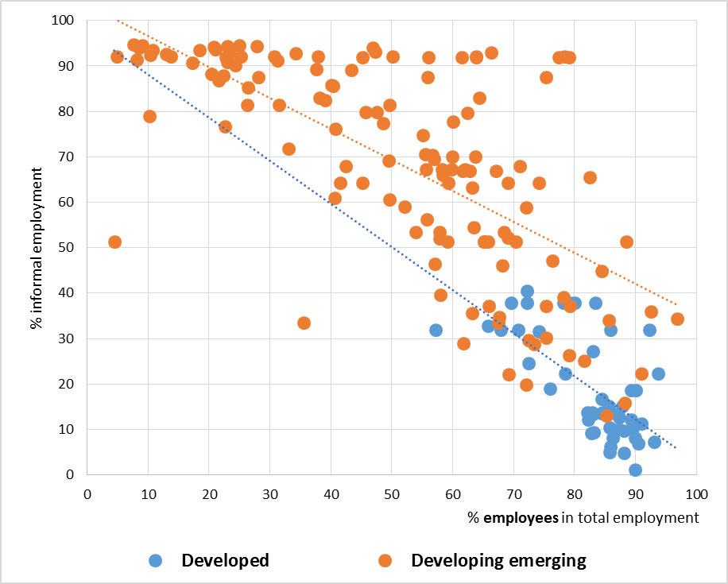
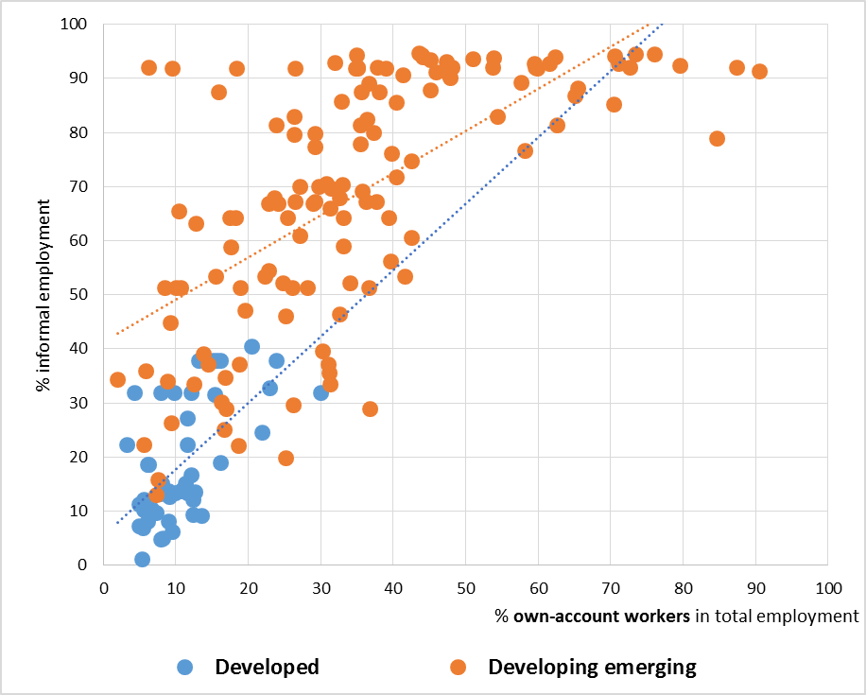
Informality and status in employment
Share of wage workers and informal employment (% total employment)
Share of own-account workers and informal employment (% total employment)

Slide 32
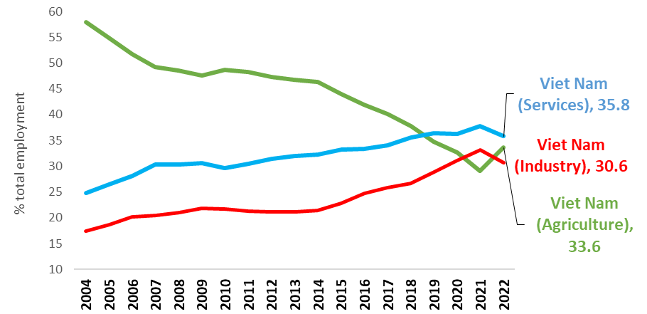
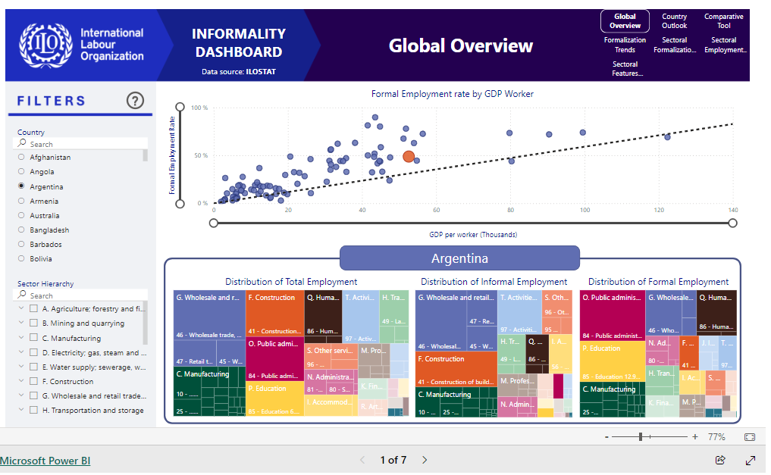
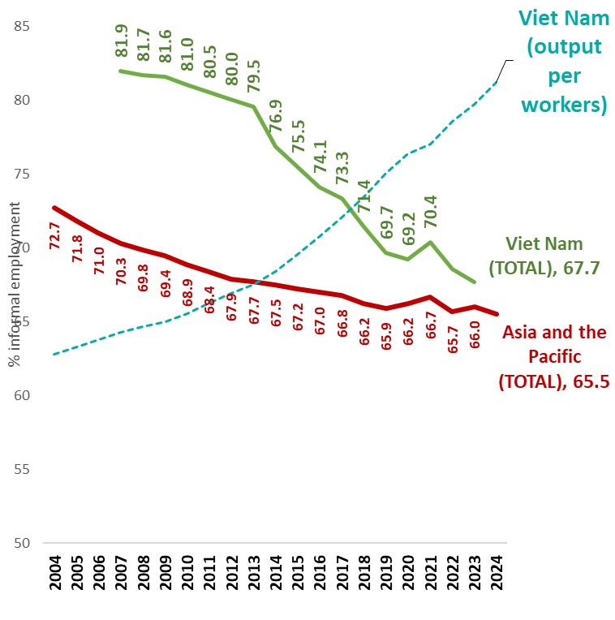
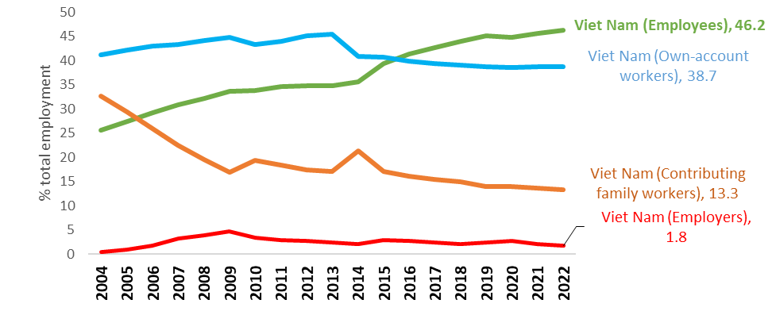
The sectoral dimension…. and other structural factors
The informality dashboard
Viet Nam: Sectoral composition of employment
Viet Nam: trends in the share of informal employment in total employment
Viet Nam: Composition of employment by employment status

Slide 33
Step 6 | Identify main actors & coordination mechanisms

Slide 34
A mapping of actors
Ministries, institutions, agencies (including statistical agency)
Main workers and employers’ representative;
Non-governmental actors both international and national
Main organizations of the informal economy
As part of the mapping
Domain of intervention; objectives and priorities
Types of informality dimensions (e.g. fiscal issues; social security and/or labour law/ ; effective implementation; other)
Main target group(s) (SMEs; self-employed or employees; specific sectors)
Main realizations, programmes: past, current and planned
Main role in the formulation and implementation of policies and programmes and those related to informal economy & formalisation
Role that could be envisaged and constraints to overcome to make their action more efficient
Understanding and visions of informality, its causes and consequences
Strengthening capacity: identify needs, if any?
Coordination
Existence of any coordination mechanism between actors; if not identification of opportunities and obstacles)

Slide 35
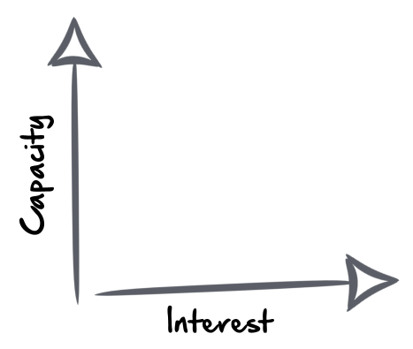
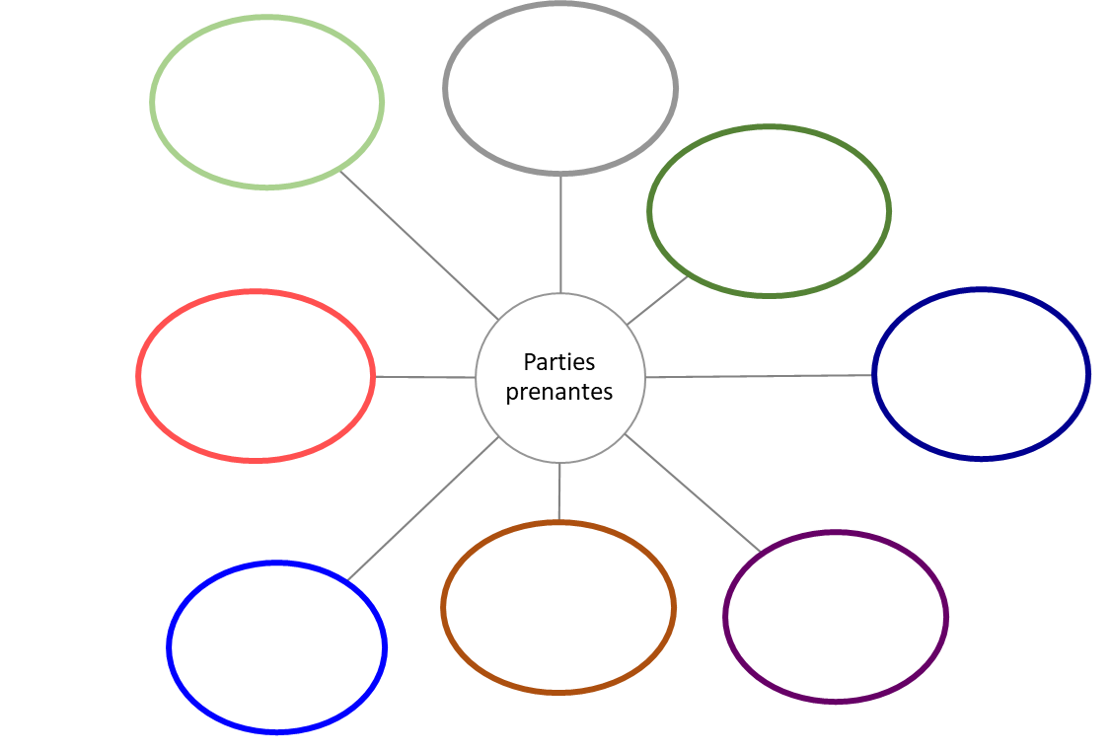

Goal: Identity and position the stakeholders in the transition to formality
Step 1 : Identify the actors
Step 1 – Identification of actors
Step 2 – Qualify the actors
Step 3 Positioning the actors
Step 2 : Qualify the actors (area, role, achievement, expectations and interest in formalization)
Step 3 : Position each of the actors according to their involvement/interest in the transition to formality, including the reduction of decent work deficits (horizontal axis) and their capacity for action and influence (vertical axis)
Stake-holders
Stake-holders
Step 4 : Assess the situation
Identify possible gaps between the interest of the actors and their role in the formalization and discuss how to fill these gaps?
Considering the main programmes, interventions and expectations/needs, identify: areas not covered; overlapping/duplication of efforts without established coordination
Ability / Influence
Area of intervention
Target group
Role, programs, achievements
Interest in formalization/ expectations
ability to act
Interest / involvement

Slide 36
Coordination
Step 1 : Identify existing partnerships between actors
Step 3 – Identify potential partnerships
Step 1 – Identify existing partnerships
Step 2 – Qualify existing partnerships
Step 2 : For existing partnerships, if possible describe
    the institutional framework
    operational methods: actors involved; their responsibilities
    involvement or consultation of social partners and (if relevant) informal economy organizations concerned;
the institutional framework
operational methods: actors involved; their responsibilities
the participation or consultation of the social partners
Ability / Influence
Ability / Influence
Step 3 : Identify potential partnerships (indicate in dotted line)
Ability / Influence
Step 4: Identify factors in the current institutional framework that represent constraints and barriers to effective coordination & opportunities to fill these gaps
Interest / involvement
Interest / involvement
Interest / involvement

Slide 37
Step 7 | Review of current, past and planned measures and policies

Slide 38
Step 7 | A mapping and assessment of main policies & measures towards formalization
Objective
Scope of the assessment
Mapping current, past and planned policies
  Assess if and how the reduction of decent work deficits in the informal economy and the transition to formality are part of main national strategic policy frameworks (national development plans, poverty reduction strategies, budgets)
  Is there any formalization strategy? Interventions targeting workers/ units in the informal economy?
  Get a better understanding of the main approach(es) opted with regard to formalization? Shifts in the type of policies adopted?
  Collect evidence (and any evaluations) on the effectiveness of measures aiming at facilitating the transition to formality.
A broad diversity of possible interventions:
Policies that affect the environment/context: Macroeconomic, trade, industrial, tax, sectoral and infrastructure policies aiming to promote employment, enhance productivity and facilitate structural transformations, etc.
Policies that affect transversal drivers of formalization, mostly to strengthen institutions, such as those to tackle poor social security systems, weak labour market institutions, lack of access to finance, to education, to skills, to infrastructures, etc.
Policies that target specific categories of economic units (e.g. MSEs), groups of workers (e.g. domestic work, self-employed), type of informality (e.g. undeclared work in formal enterprises).
Consider interventions to increase: 1) the ability of the environment to absorb the informal and 2) the ability of individuals and economic units to enter the formal economy.

Slide 39
Steps post diagnostic | Strategy => action plans

Slide 40
Steps 8-10. Validation tripartite meeting
Step 8
Tripartite meeting to validate results
Shared (tripartite) vision on the main characteristics, causes, circumstances and forms of informality in the country, possibly for a sector, a group of workers, a type of informality
Step 9
Identify priority measures
Step 10
Developing a strategy, action plan(s) / road maps (incl. responsibilities, deadlines, indicators to monitor the implementation of activities)

Slide 41
No predefined blocks but possible elements of integrated formalization stategies
1. Legislation/ regulatory & institutional framework
2. Incentives & support: making formalization easier and more “attractive ”
Extend legal coverage of labour, social, fiscal, commercial and other relevant legislation to all workers and enterprises
Improve levels of legal protection including
  Levels of benefits and advantages associated to formality
  Adjust eligibility conditions and modalities to comply (adapted / flexible/ simplified)
Information/training about rights and obligations
Simplification/ tax benefits; unification of several taxes and contributions (e.g. single tax)
One stop shop, e-formality
Access to markets; finance
Extension of social protection to difficult groups (adequate modalities)
Institutional accountability & effectiveness
3. Productivity/ skills & employability: formal jobs creation & making formalization possible & sustainable
4. Enforcement and compliance: making it less attractive to be informal
Inspection with technical assistance
  Unique identification numbers
  Effective sanction systems
  Institutional coordination
  Education/ sensitization (“culture of formality”)
Social dialogue
Coordination
Improved productivity at the global/environment level (macro) ; meso (sectors / value chains) ; micro (enterprise)
Improvement of skills, re-skilling and qualification (enhanced mobility from one job to the other)
Reducing decent work deficit in the informal economy
Use of new technologies
Enabling factors/ necessary conditions
Notes:
The ILO supports informal enterprises to become formal because this transition is a means to an end to create better jobs in sustainable, resilient enterprises. Enterprise formalization is often a requirement to formalize jobs and declare workers for social protection, thus contributing to decent work. Enterprise formalization also reduces unfair competition and enhances social cohesion.
The ILO's approach to promote enterprise formalization is based on a four-pronged strategy based on social dialogue (diagram):
Make it easier to register and comply
Make it more attractive to formalize
make it more feasible to formalize
make it less attractive to be informal

Slide 42
Some references
R204 - Transition from the Informal to the Formal Economy Recommendation, 2015 (No. 204):
https://www.ilo.org/ilc/ILCSessions/previous-sessions/104/texts-adopted/WCMS_377774/lang--en/index.htm
ILO - Transition from the Informal to the Formal Economy – Theory of change: https://www.ilo.org/global/topics/employment-promotion/informal-economy/publications/WCMS_768807/lang--en/index.htm
Methodological note. Diagnosis of informality
Women and men and men in the informal economy: A statistical update (ILO, 2023)
Making decent work a reality for domestic workers: https://www.ilo.org/global/publications/books/WCMS_802551/lang--en/index.htm
The ILO informal economy webpage

Slide 43
GroupWork |
Back to Abelina case

Slide 44

Case study | Abelina
A rapid diagnostic of the situation in Abelina have been carried out so far but more needs to be done.
David Swift received this briefing note that presents the first results of the quantitative analysis (extent, composition, workers most exposed to and workers most represented in informal employment)… based on your earlier contribution.
It also presents some of the factors of informality associated with the legal, institutional and economic environment. The objective is to build on the indicators and to identify what could be some of the causes of informality common to all workers or specific to particular groups) to start proposing measures.
Time is flying and David Swift has decided to split the team in four groups, so that each group can focus and deepen the analysis:
  Groups 1-2: focus on employees in informal employment (except for question 1)
  Groups 3-4: focus on independent workers of small and micro enterprises (own-account workers and employers) (except for question 1)
The group in charge of the implementation of R204 in Abelina counts on you to provide some answers to the following questions:

Slide 45
Case study | Abelina
First step
Question 1. Building on results from session 3.1 and additional information provided to you, could you start identifying some groups that could be given priority in the formalization process
  Provide arguments to justify your choice?
The following sub-questions can help in this process:
  Question 1a. Who are the most exposed to informal employment?
  Question 1b. Who are the most represented among workers in informal employment?
  Question 1c. Who are those the most exposed to decent work deficits or, broader, to the most critical vulnerabilities?

Slide 46
Case study | Abelina
Second step
Question 2. What are, according to you, some of the main causes of informality for the group you are focusing on:
  Group 1: Employees in informal employment;
  Group 2: Independent workers
You can consider factors as part of:
  personal and employment related features that can make difficult to transition to formality
  the legal and regulatory framework
  the economic environment

Slide 47
Case study | Abelina
Third step
Question 3. What type of measures would you suggest for the group you are focusing on to create the enabling conditions for formalization later or to support formalization now?
Question 4. How could we complement this diagnostic with additional facts to be in a better position to define priorities and support the development of appropriate measures? This concerns notably:
  Issues to be covered,
  Data to be collected and most appropriate source and method.
  Additional analysis needed.

